Slide 1
Family group conferences in Norway
Svanhild Vik svanhild.vik@bufdir.no
National coordinator FGC

Slide 2
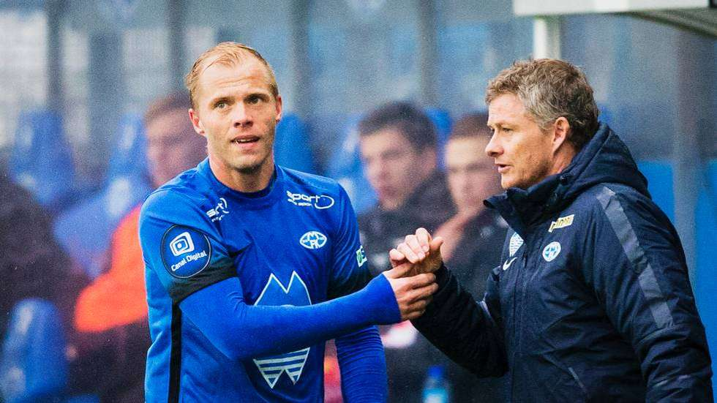
Roots

Slide 4
This presentation
Introduction to the method
Use of FGC in different areas
Experiences from implementation in Norway
Notes:
A major challenge for the child welfare system is the balance between a time-sensitive, child protective approach – and the efforts to engage families in problem solving and confronting child welfare agencies to provide services in a manner that uses cultural and community strengts.
In my opinion / and what I experienced often was that clients / citizens often was:
Separated from their own decision making

Slide 5
Family group conference
Family group conferencing is a means of involving family and close support persons in making and carrying out plans to safeguard children
Since the emergence of FGC in New Zealand in 1989, the method has spread and developed
FGC in child welfare (can be used in all kind of situations) – also outside the child welfare system
In accordence with Childrens convention and EMD
FGC into the child welfare law

Slide 6
Do we believe in participation?
Risk for citizens
Separated from decision making
Loss of autonomy
No bonding to plans
Resistance
Citizens want
Control about their own lifes
Information about possibilities
Coherence in service

Slide 7
Principles in FGC
Coordinator must be neutral in relation to child welfare office
The extended network of family is mobilised
The child welfare office have a positive attitude toward the presented plan
The family and network must be alone without professionals in stage two of the meeting
The child participates in the FGC

Slide 8
The use of FGC in Norway
Municipalities child welfare: 800 new FGC in 2017
All types of cases, Pilotproject in five municipalities in cases with violence / high conflicts cases
Stately level: 600 FGC in 2017
Child welfare institutions, for instant MultifunC, fostercare, family mediation, Youth prison
Outside child welfare: «FGC 0-100 years» (school, mental health, disabled children, addiction, NAV etc)

Slide 9
The process of FGC
Preparation
Contract meeting
Working in the network
Family Group meeting
Plan into action
Following up FGC
1
2
3
Caseworker Parents /Familly Child / children | Caseworker Parents /Familly Child / children | Caseworker Parents /Familly Child / children Coordinator | Caseworker Parents /Familly Child / children Coordinator Extended family Other professional key persons | Parents Children Network / Extended family |  |  | Caseworker Parents /Familly Child / children |  | Caseworker Parents /Familly Child / children New persons?
 |  |  |  |  | Parents Children Network / Extended family Coordinator

Slide 10
Implementation team One national and regional coordinators
North: 2 persons
Central Norway: 3 persons
West: 3 persons
South: 1 person
East : 2 persons
National coordinator : 1
Notes:
While our headoffice is located in Oslo, we have five regional offices located across Norway.

Slide 11
Summery from research
The results of Family Group Conferencing are significant positive, also compared to traditional methods in the comparison group. FGC will contribute to creating positive processes of change that may be fundamental for those involved.
Positive experiences by participants
Coordinator has an essential role
FGC leads to more placement in family and network
Good evaluation in high conflict cases (2016)
Very positive results regarding FGC in emergency cases. This leads to a new research project

Slide 12
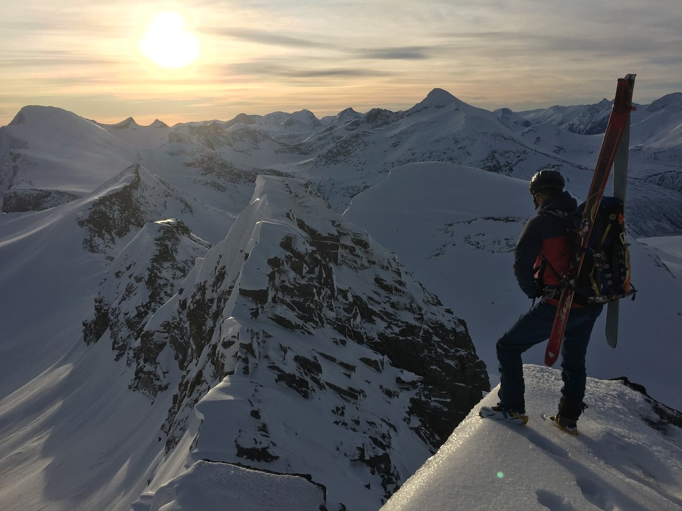
Futher steps FGC Norway in cases with violence
FGC norwegian evaluation of pilot project in domestic violence
Shuttle- conferences – implementetion and developement
Cooperation with police and other professional key persons
Focus on fathers roles in childrens lives (child welfare)
International research FGC: Pennell and Burford (2000), Morris (2007)
………………..

Slide 15
FGC in education
Individuals / groups
Behavior problems, social exclusion, absence from school
Involvement of parents

Slide 16
Challenges
Implementation in charge of a Directorate when social workers in the municipalities must have ownership to the values and method
Outcomes of FGC is «taylor-made». Systems want ready made solutions. «Translation»
The context of the country is important when implementing a method. Adaptions are to some extend necessary
Childrens participation in general. In FGC participations in the whole process is a goal. Both in the preparation and when carring- out the plan. Childrens participation is an overall focus
Implementation must be considered long term
Fidelity. Necessary to have ”national standards” in FGC, but also to experiment

